Slide 1




Chapter 9:
Filecoin Blockchain & Consensus
Beginners Guide to Filecoin
Content created by Brown Zhang
Researcher @ KEN Labs

Slide 2
Blockchain+Actors
An Actor in the Filecoin Blockchain is the equivalent of the smart contract in the Ethereum Virtual Machine. It is essentially an ‘object’ in the Filecoin network with a state and a set of methods that can be used to interact with it.
contains:
Built-in actors：System Actor,Init actor,Cron Actor,Account Actor,Reward Actor,Storage Miner Actor,Storage Power Actor,Storage Market Actor… (These actors power the Filecoin network as a decentralized storage network.)
User-programmable actors:User-programmable actors can also interact with built-in actors using the exported API from built-in actors

Slide 3

Distributed randomness
Filecoin uses distributed and publicly verifiable random beacon protocol - Drand as the randomness beacon for the leader election during the expected consensus to produce blocks. This randomness guarantees that the leader election is secret, fair, and verifiable.

Slide 4
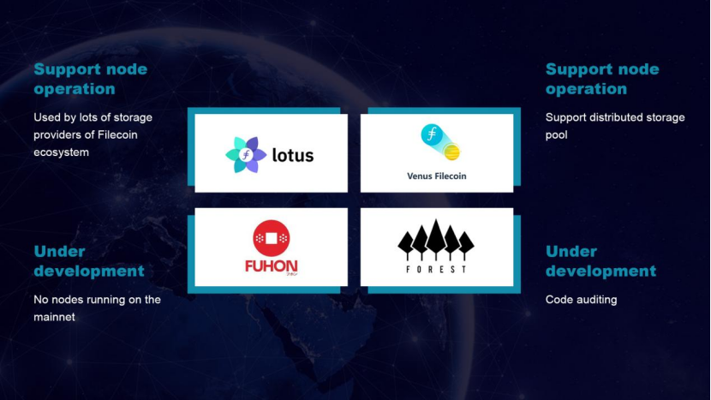
Nodes
Nodes in the Filecoin network are primarily identified in terms of the services they provide to serve the Filecoin storage network, including chain verifier nodes, client nodes, storage provider nodes, and retrieval provider nodes.
Mainly include：Lotus, Venus, Forest

Slide 5
Addresses
In the Filecoin network, addresses are used to identify actors in the Filecoin state.
f0/t0: an ID address for an actor in a more “human friendly” way.
f1/t1: a secp256k1 wallet address with encrypted key pair.
f2/t2: an address represents an actor (smart contract) and is assigned in a way that makes it safe to use during network forks.
f3/t3: a BLS wallet address generated from a BLS public encryption key.
f4/t4: the addresses which were created and assigned to user-defined actors by user-definable “address management” actors.
f410/t410: the address space managed by Ethereum Address Manager (EAM) built-in actor.

Slide 6
Consensus
OverView
In the Filecoin blockchain, network consensus is achieved using the Expected Consensus (EC) algorithm, a secret, fair and verifiable consensus protocol used by the network to agree on the overall chain state at each epoch, including the storage power currently available in the network.

Slide 7
Consensus
Properties
Expected Consensus (EC) has the following properties:
Each epoch has potentially multiple elected leaders who may propose a block.
A winner is elected randomly from a set of network participants weighted according to the respective storage power they contribute to the Filecoin network.
All blocks proposed are grouped together in a tipset, from which the final chain is selected.
A block producer can be verified by any participant in the network.
The identity of a block producer is anonymous until they release their block to the network.

Slide 8
Consensus
Steps
EC involves the following steps at each epoch :
A storage provider checks to see if they are elected to propose a block by generating an election proof.
Zero, one or multiple storage providers may be elected to propose a block.
Each potential block producer elected generates a storage proof using WinningPoSt for a randomly selected sector within in short window of time.
Blocks generated by block producers are grouped into a tipset.
The tipset that reflects the biggest amount of committed storage on the network is selected.
Using the selected tipset, the chain state is propagated.
EC returns to step 1 in the next epoch.

Slide 9
Conclusion
The Filecoin blockchain is a chain of tipsets rather than a chain of blocks. A tipset is a set of blocks with the same height and parent tipset. Therefore, multiple storage providers can produce blocks for each epoch to increase network throughput.
Each tipset is assigned a weight, so the consensus protocol directs nodes to build on the heaviest chain. This provides a certain level of security to the Filecoin network by preventing a node from intentionally intervening with other nodes to produce valid blocks.

Slide 10


Feedback is welcomed.
https://github.com/kenlabs/Beginners-Guide-to-Filecoin

